Slide 1
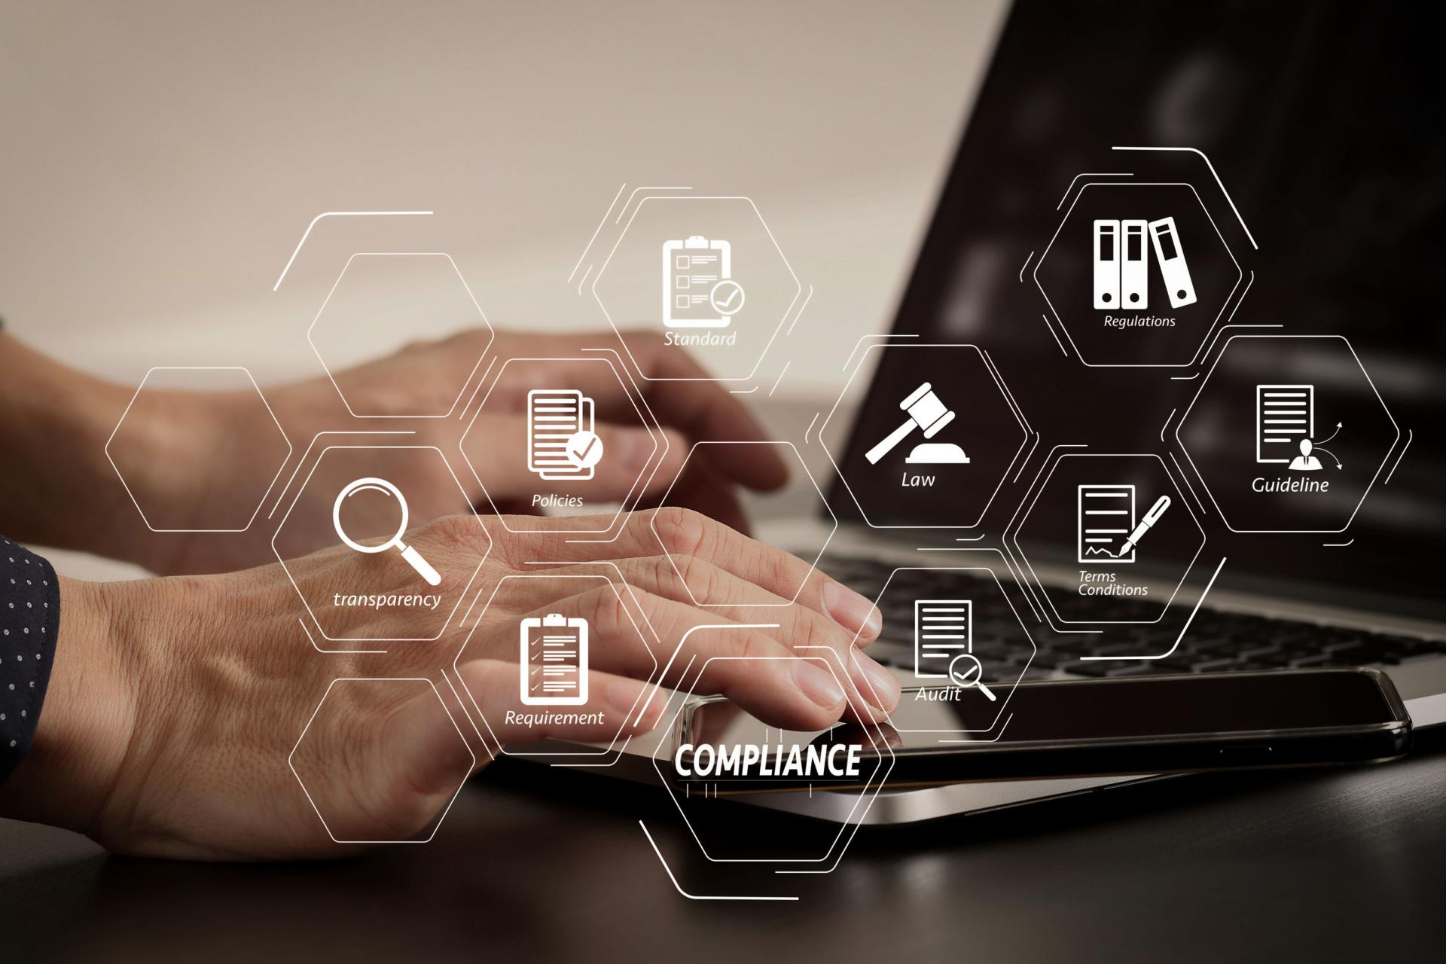
Project manager
Sarowar Malla
Samir Shrestha
Melina Rayamajhi

Slide 2




Contents
Introduction
Objectives
Features
Importance
​

Slide 3

Introduction
It is a web-based platform that is useful to students and project managers for the management, tracking and supervision of projects.

Slide 4

Problem
Tedious way
Time management
Managing the project activities manually is really a tedious way.
As it requires lot of time and man power, proper time management issue arises.
Not secure
By their very nature, papers are susceptible to damage from water, fires, or other natural causes.

Slide 5

Objectives
To track activities of projects in efficient way.
To develop efficient communication and productive guidelines.
To achieve project goals within the estimated time with quality.

Slide 6




FEATURES
Efficient
Monitoring
Group
Evaluation
Time
Management
Task
Feedback
Supervisor will update the progress of every groups project
Group strength will be evaluated based on their performance
Digital process consumes less time comparatively
User can provide feedback to every task

Slide 7
Importance
Clear Concept
Quality control
Orderly process
Proper structure is to be followed to complete the project
Regular examine results in consistent hit to mark
Ensures to do right things at the right time through out project life cycle

Slide 8
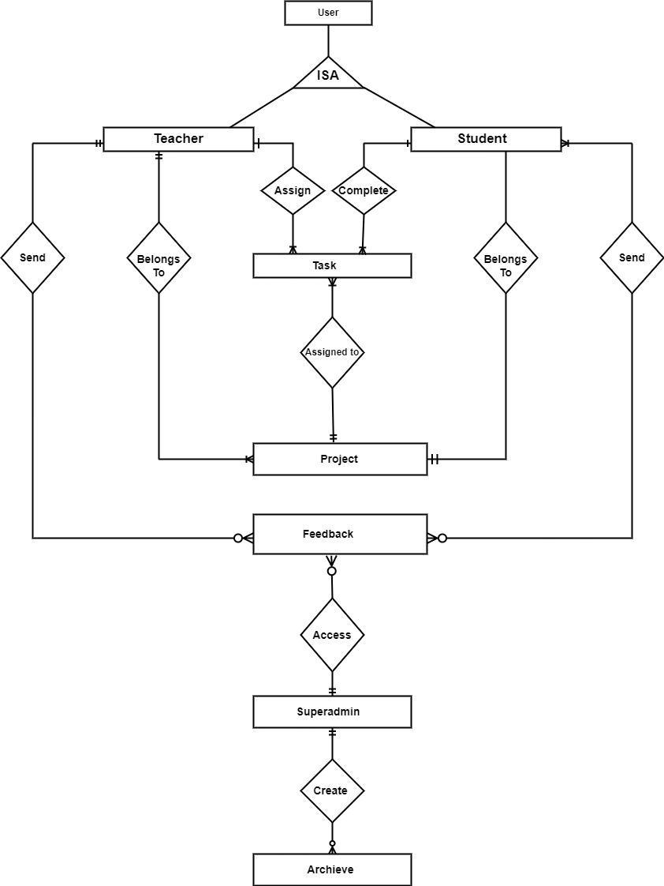
Entity relation diagram

Slide 9
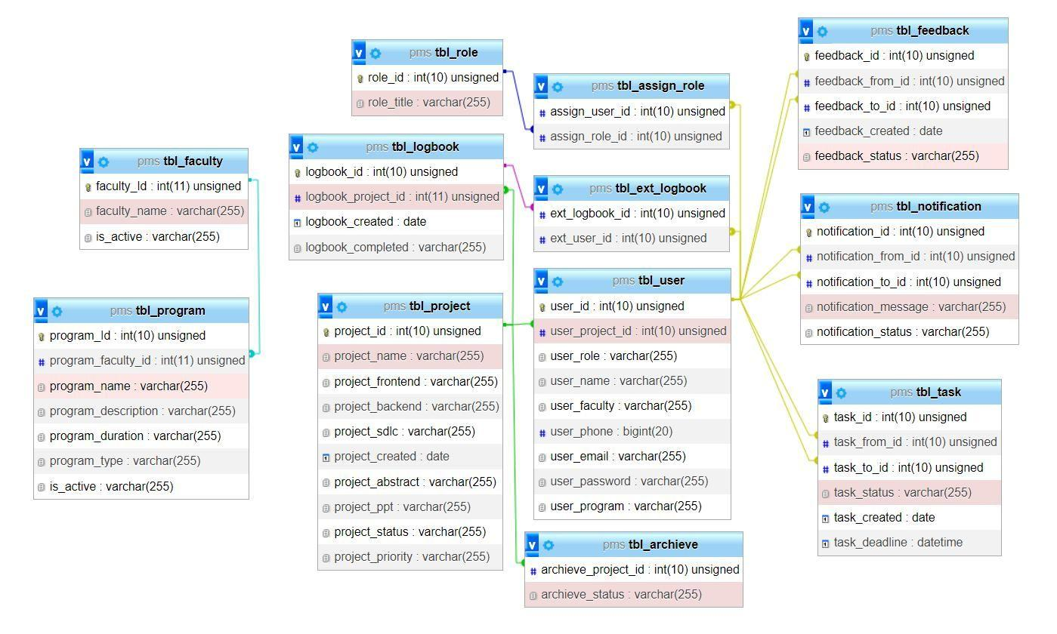
Relational data structure

Slide 10
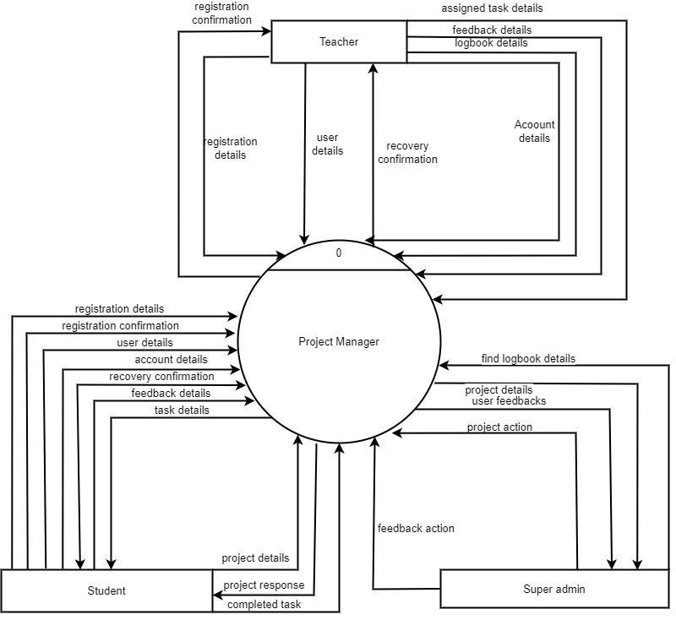
Dfd-0

Slide 11
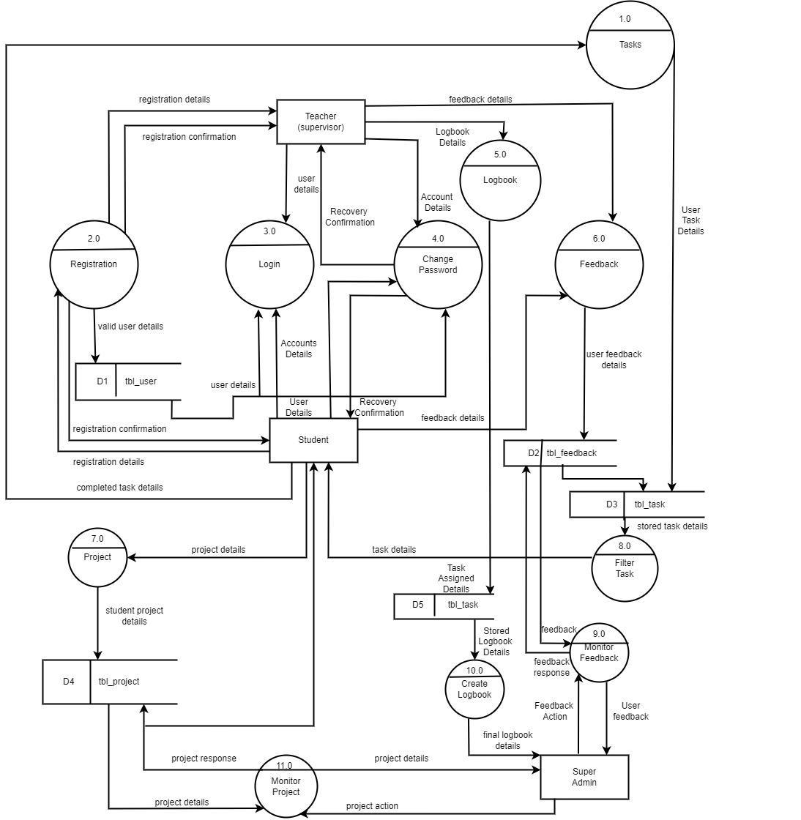
Dfd-1

Slide 12
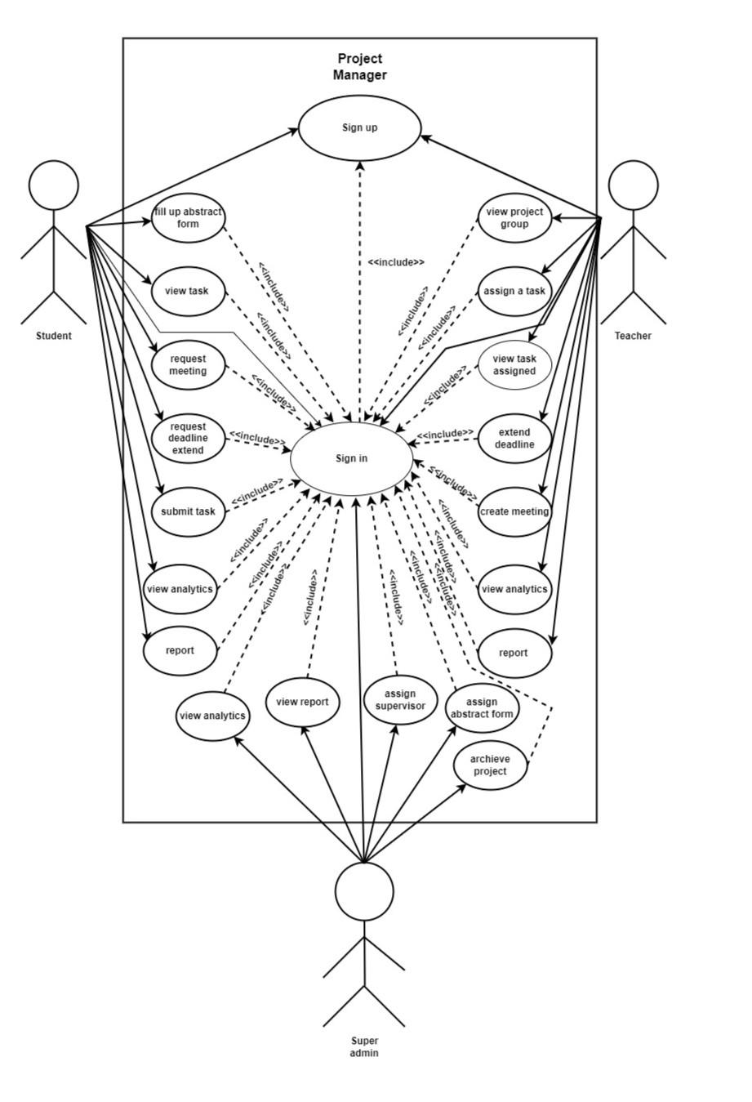
Use case diagram

Slide 13
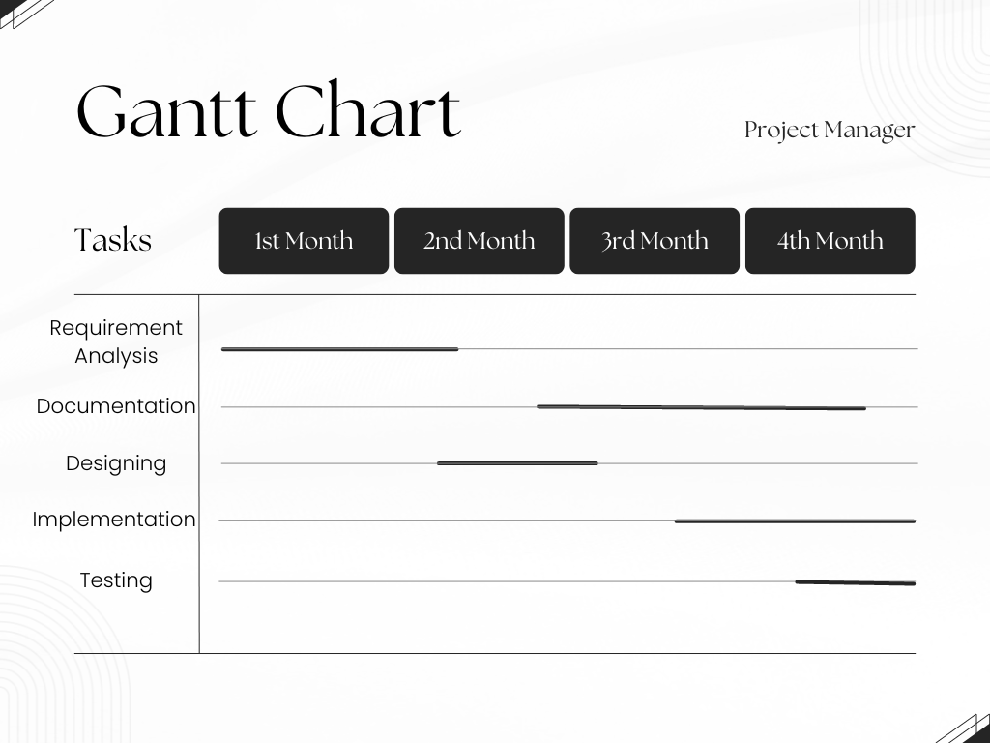

Slide 14
Summary
The main goal of this project is to build an integrated website to handle project activities.
Deadline 1
Deadline 2
Deadline 3

Slide 15
Project
manager
Thank you

